Slide 1
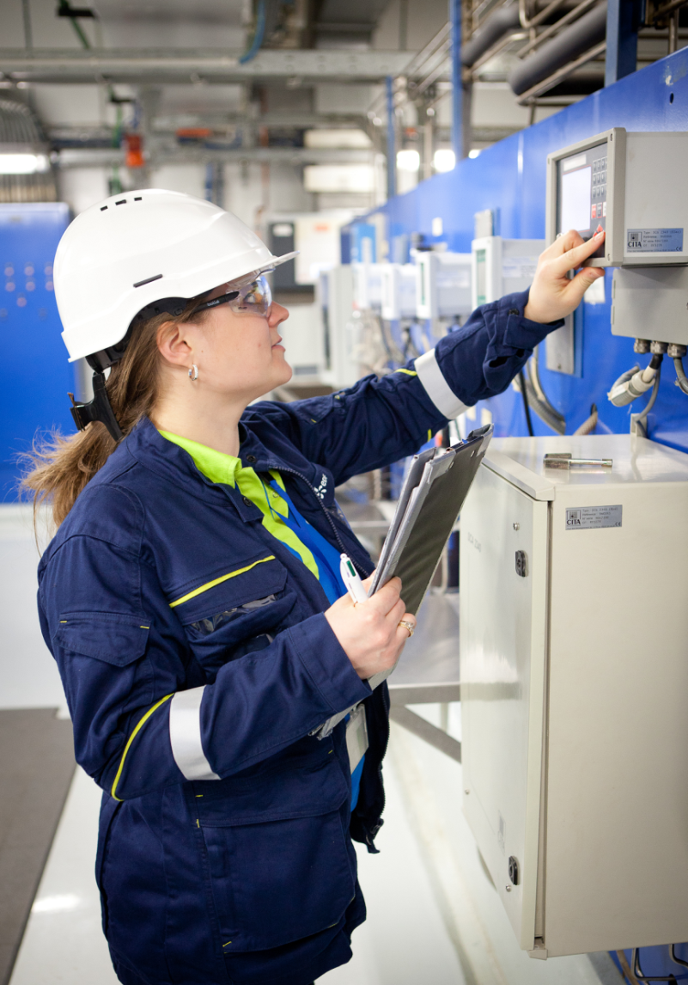
For more information
about the
If you are a woman then working in the nuclear energy for 3 years,
Participate and win
“We are for a long time engaged in the promotion of diversity”… “We wish to reaffirm the principle of the access to all – men and women – to the whole of our business”.
Philippe Sasseigne, Director of the Division of the Nuclear Production (June 2016 Fem' Energia 2016 Award Ceremony).
Submit your application on
www.edf.fr/FEMEnergia
Women in the nuclear industry
WiN (Women in Nuclear) is a network of women working in nuclear field (energy, aerospace, medicine, biology, art…). WiN France and WiN Europe belong to the WiN Global represented in more than 100 countries
Contacts
Stéphanie JUHEL
Division Production Nucléaire
Délégation Ressources Humaines Management
1 place Pleyel
Bureau B – 06 - 080
93282 Saint-Denis Cedex
Email : femergia@edf.fr
Tél. : +33 (0) 1 43 69 27 73
Valérie PONTIER
Courriel : contact.win@sfen.org
The main goals of WiN France and WiN Europe are :
• to promote the scientific and technical careers and to facilitate the access to the first job for the young people,
• to contribute to the development of the diversity and gender balance in the jobs in the nuclear industry by preparing the talents of tomorrow.
• to communicate on the assets of nuclear energy.
• to exchange experience and to share good practices.
• to offer its competences and its collective expertise to the actors of the sector, in particular, in the fields of the education and the transmission of knowledge.
Energy is our future, save it!
EDF DPN – DRHM - Photo © Médiathèque EDF – Querel David, Didier Marc, Morin Alexis et Balloffet Gabrielle
EDF
Direction du Parc Nucléaire et Thermique - DRHM
Cap Ampère - 1, place Pleyel - 93282 Saint- Denis Cedex
EDF SA, Share Capital of 1 505 133 838€ – 552 081 317 R.C.S Paris
Head Office: 22-30 avenue de Wagram – 75382 Paris Cedex 08 - France
www.edf.com
Build your professional future with us!
www.win-france.fr
www.win-europe.org

Slide 2
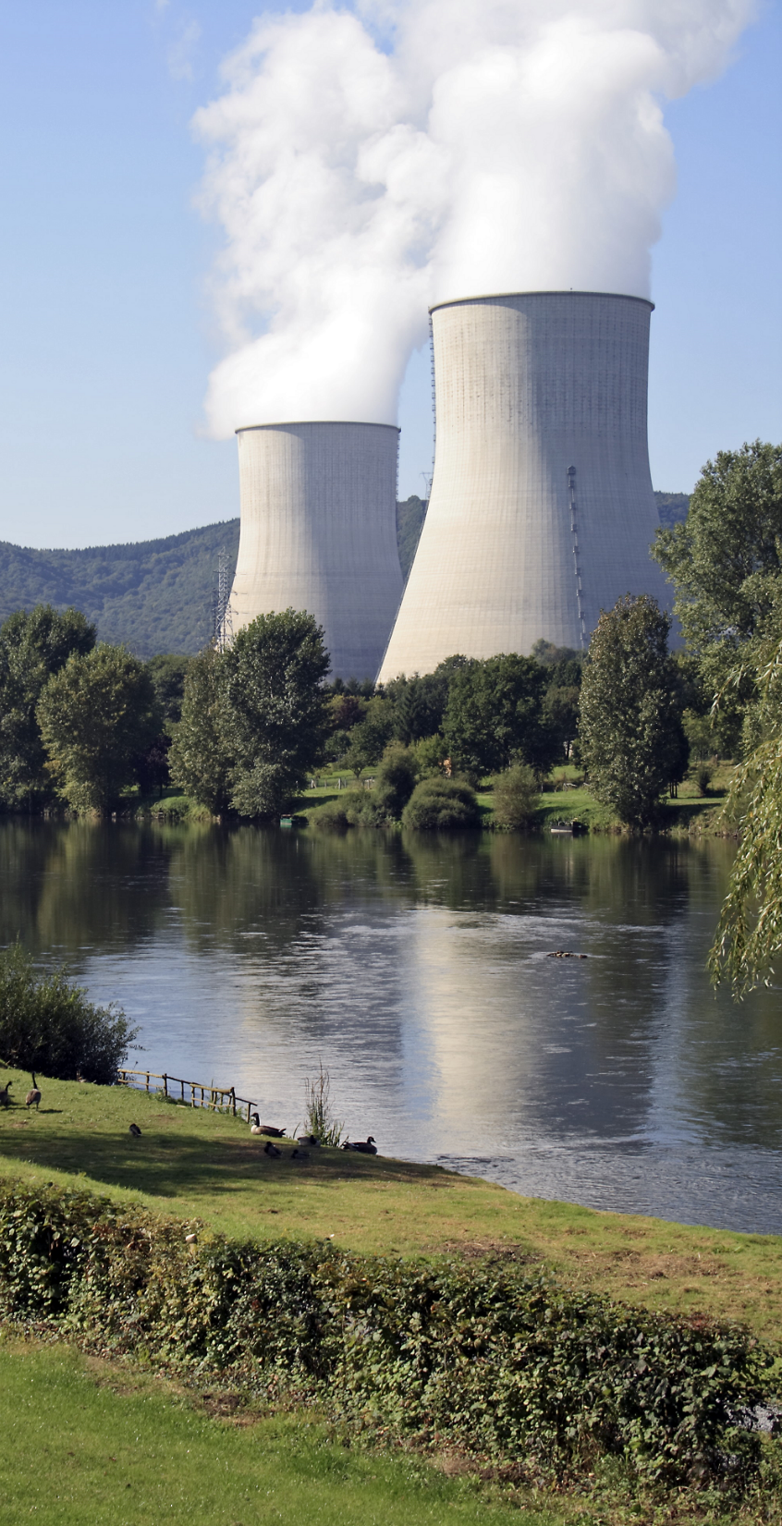
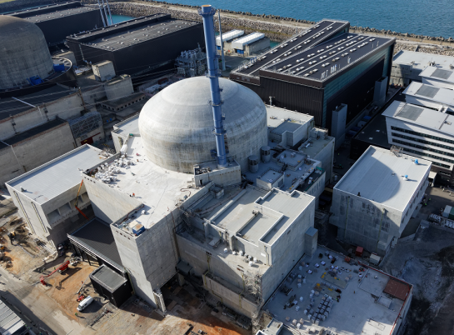
Through the Fem’Energia award EDF, WiN France and WiN Europe aim to provide encouragement and guidance to young women involved in the nuclear industry.
Nuclear power, a source of energy
for the future
Global energy demand is ever increasing, fossil fuel resources (oil, gas and even coal on the longer term) are limited and we need to counteract planet warming,
Nuclear power, generating no greenhouse gases,
provides a sustainable solution to these issues.
Build your career in a modern technology
Diversified technical jobs, both demanding and exiting,
Various different career paths tailored to your potential.
EDF, a leader of nuclear industry
Operates the world’s first nuclear power generation park,
More than 78% of the electricity produced each year by EDF in France is of nuclear origin,
Major player in the nuclear revival, through the
construction of the EPR in Flamanville (Manche),
Technical know-how and expertise acknowledged
worldwide,
International career prospects: EDF plans to invest in the construction and operation of nuclear power plants abroad, particularly in the United Kingdom and China.
2 CATÉGORIES Women in activities :
• professional women working (*) in the nuclear sector in Europe, Switzerland or United Kingdom
• collective application
Registration between February 25th and May 12,2019
Award ceremony October 2019
TO WIN
Women in activity
• 1er prize : 2000 euros
• 2nd prize : 750 euros
• 3rd prize : 300 euros
Collective application : in the form of a gift voucher
• 1er prize : 2000 euros
• 2nd prize : 750 euros
• 3rd prize : 300 euros
Application form and rules:
www.edf.fr/FEMEnergia
www.win-france.org www.win-europe.org
(*) minimum 3 years

